Slide 1
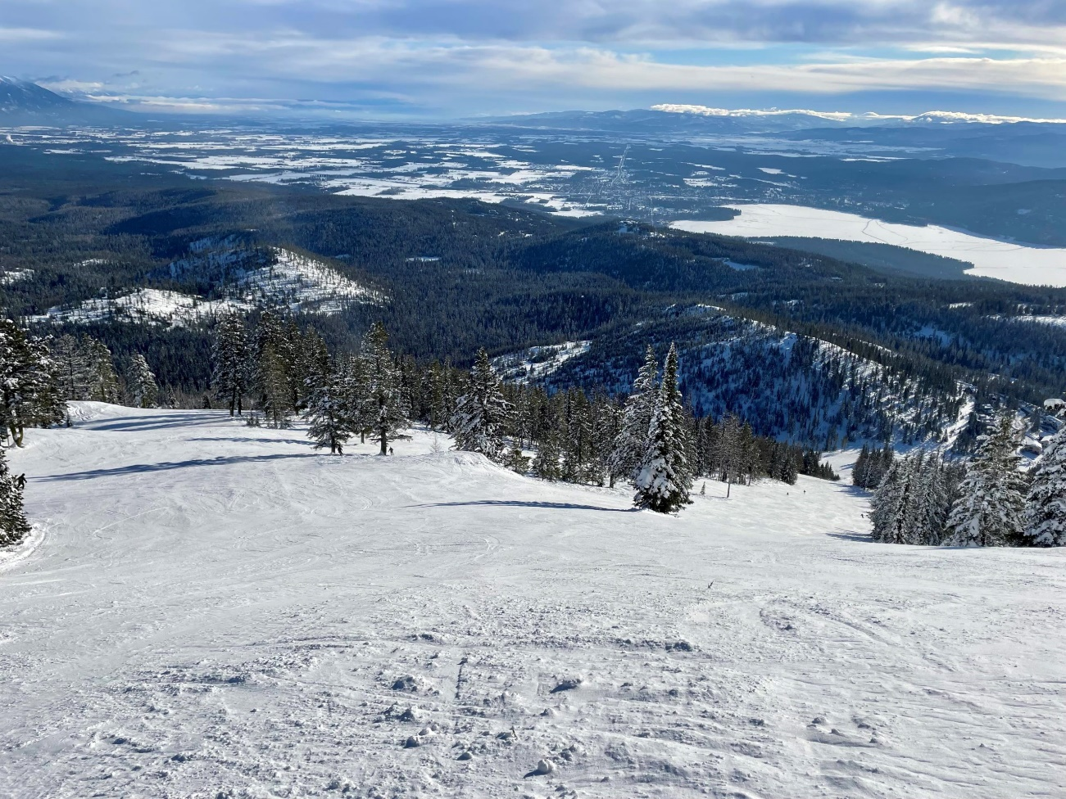
Big Mountain Resort
Competitive Pricing Opportunities

Slide 2
Problem Statement
What Opportunities exist for Big Mountain resort to develop and implement a new pricing strategy that can maximize capitalization in their new facilities’ investments to offset their recent operational costs by $1,540,000 this season
Project Context
Big Mountain Resort overlooks Glacier National Park and Flathead National Forest. With access to an abundant 105 runs and attracting 350,000 customers this year, there is a desire to capitalize on the opportunity for a better pricing strategy to take full advantage of the market.

Slide 3
Current Pricing Strategy
Currently Big Mountain Resort implements a non-dynamic market average for their pricing strategy, which is unsustainable with recent increased operating costs and will lose out on an edge over the competition
Recommendations
Our model shows that Big Mountain Resort’s pricing model is 16.31% lower than the predicted model price and the resort has many potential scenarios for either cutting costs by closing runs or increasing ticket prices by adding vertical drop, more snow making, or increasing the longest run.
Increasing the vertical drop by 150 ft would increase ticket price to $89.46, resulting in a revenue increase of $14,811,594.
Adding 2 acres of snow making would increase the ticket price by 12% to $90.75, resulting in a revenue increase of $17,068,841.

Slide 4
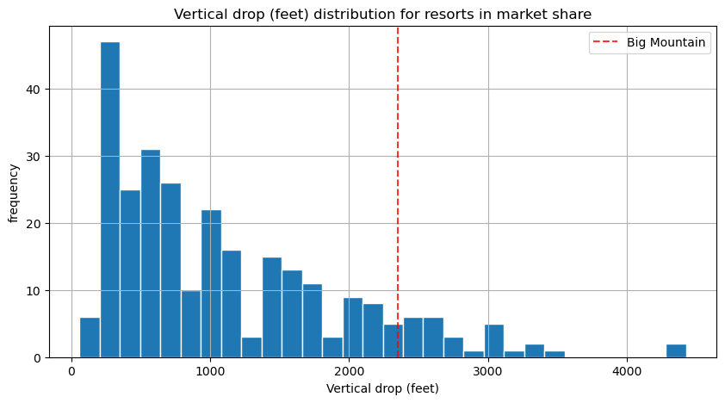
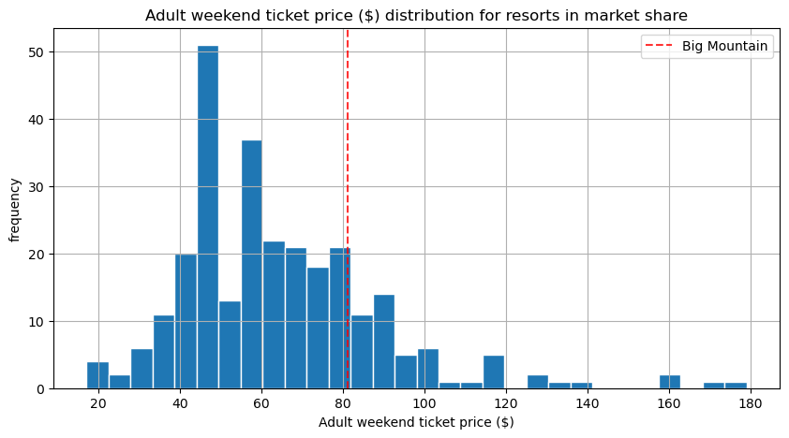
Vertical Drop and Weekend Price

Slide 5
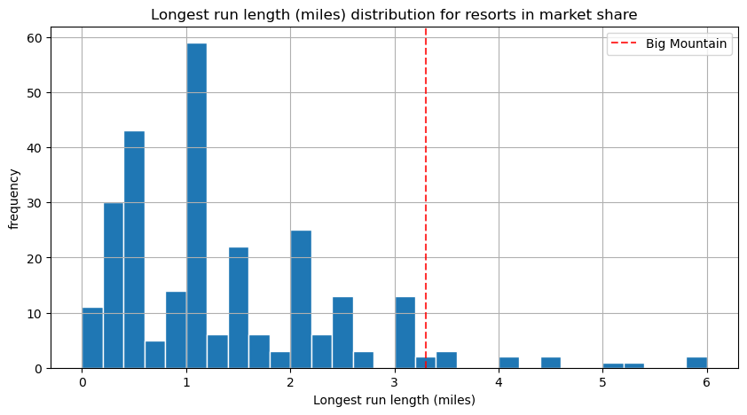
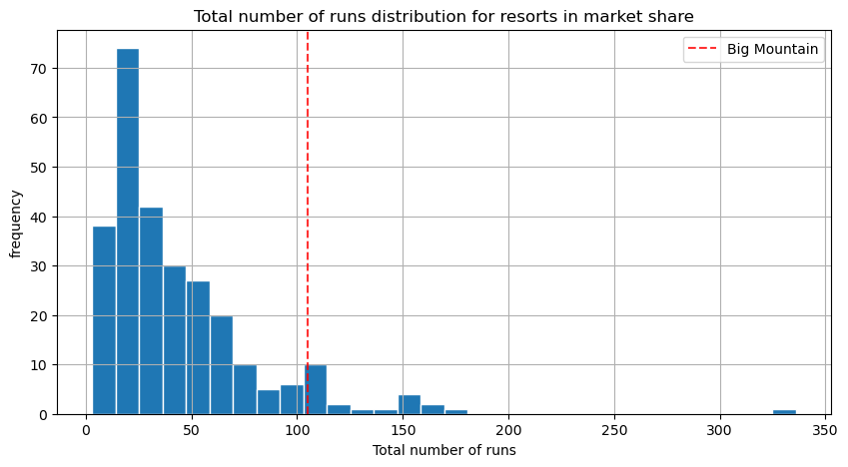
Longest Run and Number of Runs

Slide 6
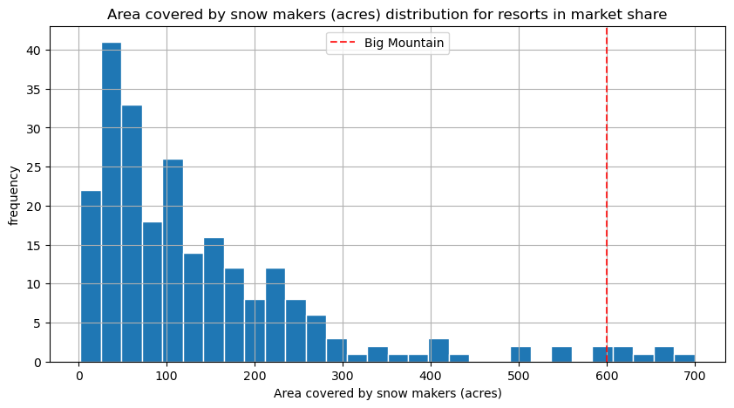
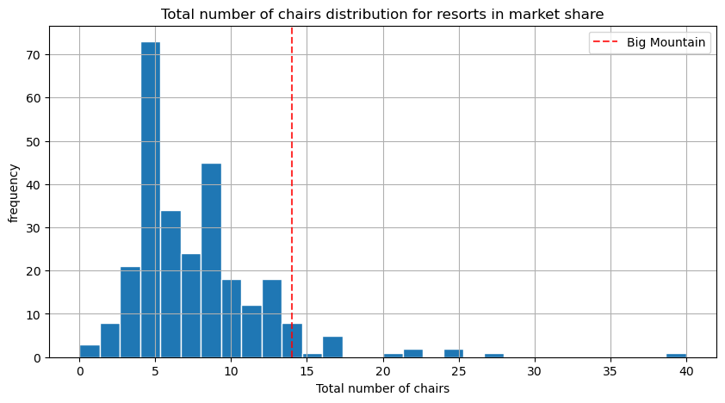
Snow Making Area and Number of Chairs

Slide 7
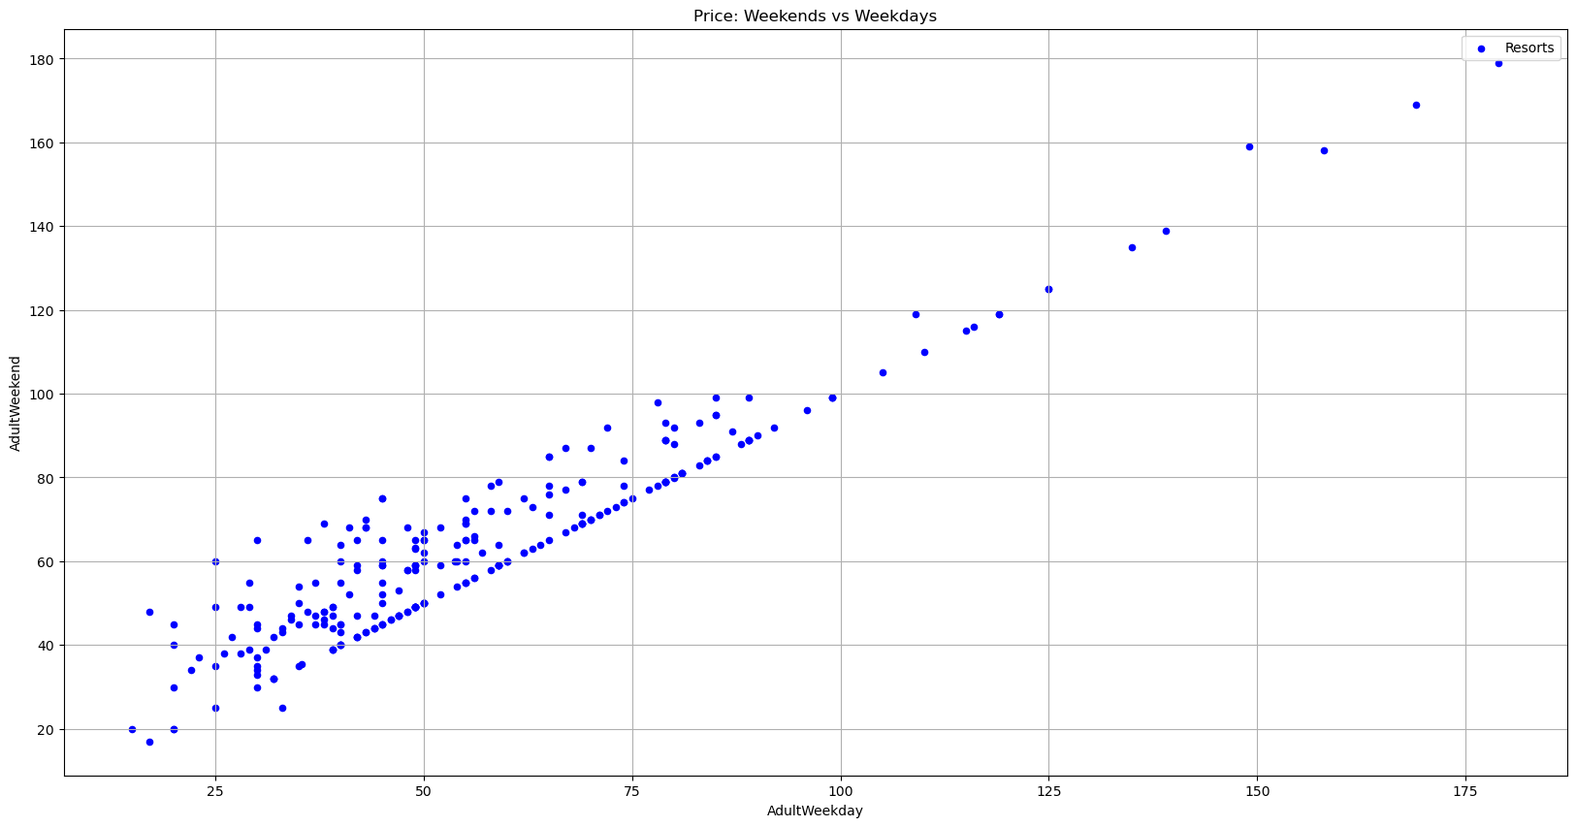
Pricing Strategy
Higher on the weekend and lower on the weekday
This takes advantage of more customers on weekend, and attract more on the low weekdays
As seen on the right, most US resorts employ a dynamic pricing strategy

Slide 8
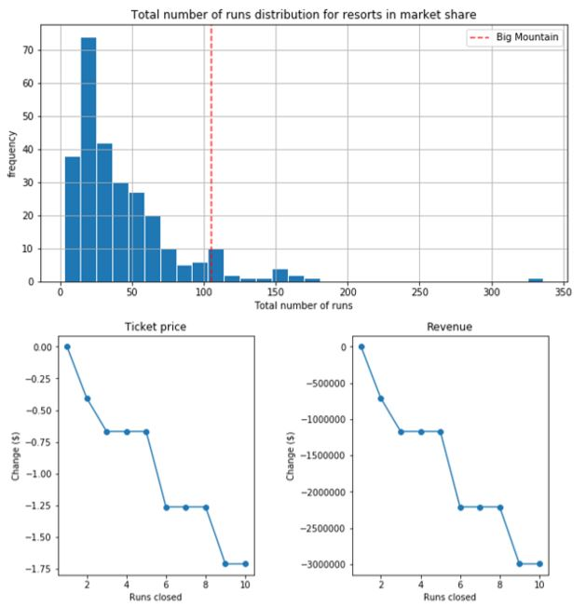
Closing up to 10 runs
Big Mountain Resort has reviewed a potential scenario for cutting costs be permanently removing up to 10 least used runs.
Our model predicted the following scenarios:
Up to 1 run closed-0 Change
2 runs- loss in revenue of $750,000
3 to 5 runs- loss in revenue of $1.25M
All 10- loss in revenue of %3M
Since we do not know the operating costs per run, we cannot determine if this is a correct strategy or not

Slide 9
Conclusion
From our model for our ticket prices, running through the potential scenarios given has led to the following conclusion:
The best scenario was achieved by increasing the vertical drop by 150ft, adding 1 chair lift, 1 run, and 2 acres of snow making. This increased ticket price to $90.75 resulting in a net revenue of $15,528,841.
Because we are missing data on weekend price and operating cost per run, our model currently cannot recommend a dynamic pricing or closing runs

